Slide 1
HPE – Outdoor Education
Year 9 and 10

Slide 2
Outdoor Education
The focus of this subject encompasses learning about self, others and the environment through a variety of theoretical, practical and experiential learning activities.
Outdoor Education provides a context for students to develop self-reliance, interdependence and leadership in outdoor and natural environments, and to understand and explore human-nature relationships in theory and through self-reflection.
Students are engaged in outdoor and adventure activities that promote the development of an adventurous spirit with an emphasis on managing personal risks, conducting safe journeys in nature and the valuing outdoor recreation for enjoyment, health and wellbeing.

Slide 3
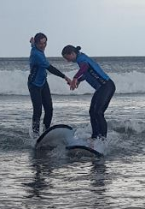
Outdoor Education cont.
Aspects of this course are inherently physically challenging and include exposure to the elements. Some of these are in aquatic environments and being a competent swimmer is advantageous.
Some basic outdoor clothing would be helpful, including warm insulating layers such as thermal and fleece garments, a waterproof coat with hood and sturdy durable footwear. This is a one year course that can be studied in either Year 9 or Year 10

Slide 4
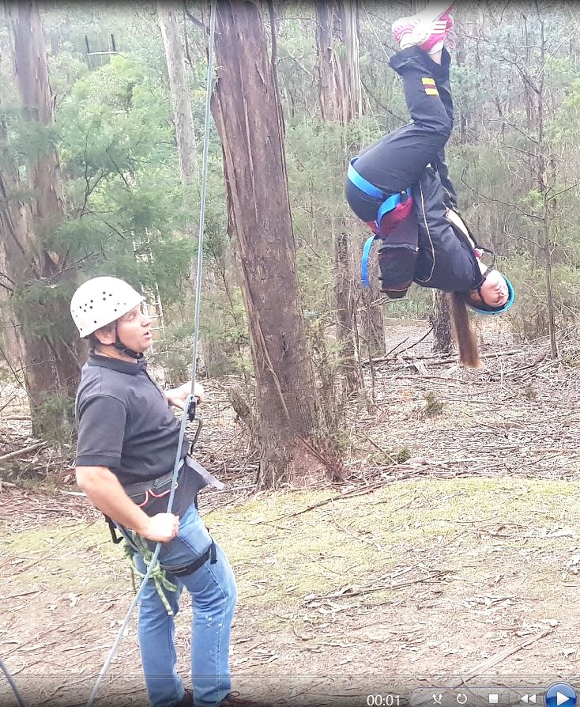
Why Should I Take Outdoor Education
I want to join a class with exciting content that is very active and engaging.
I want to improve my personal organisational skills.
I want to expand my appreciation of the natural environment.
I want to build on my previous outdoor experience.
I wish to gain the confidence to lead a group of peers.

Slide 5
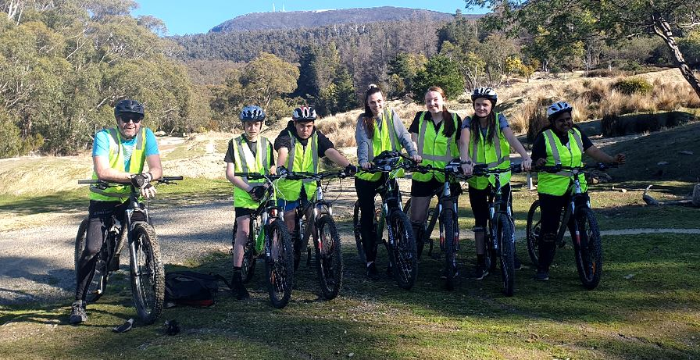
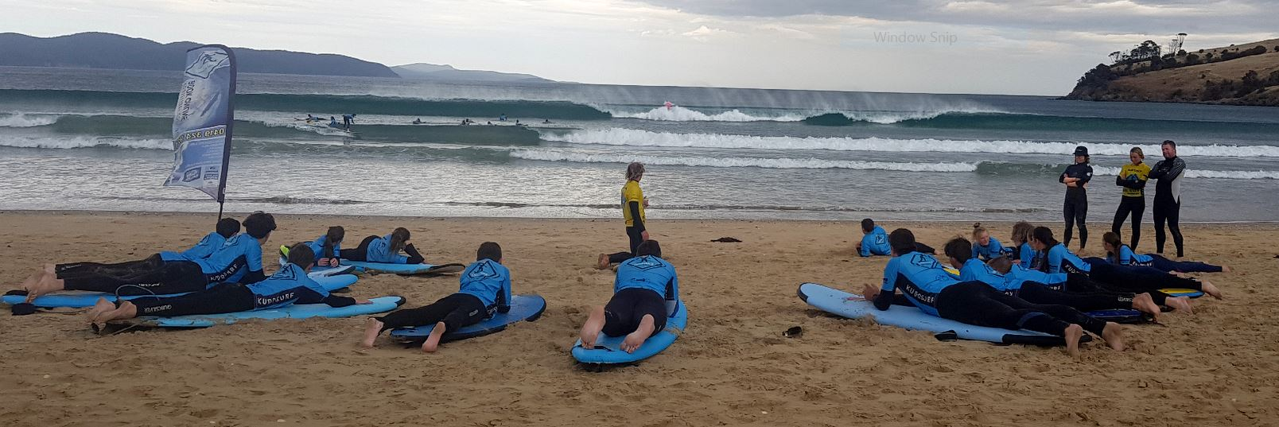
Outdoor Education Careers
Outdoor Instructing
Tourism
Emergency Services
Teaching
Armed Forces
Youth Programs
Recreation Co-ordinating
Surf Lifesaving

Slide 6
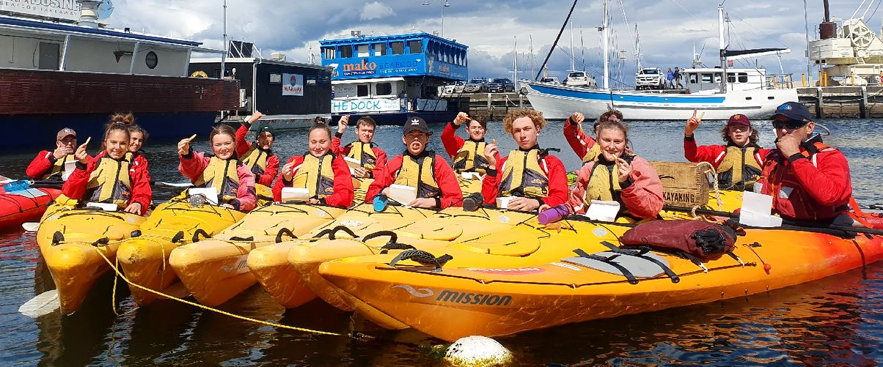
Topics Covered
Leadership Styles
Group Dynamics
Hazard Identification
Surfing
Mountain Biking
Orienteering
Expedition Planning
Navigation
Rock Climbing/High Ropes
Sea Kayaking
Orienteering
Expedition Planning
Navigation
Rock Climbing/High Ropes

Slide 7
Engaging Activities
Students will be introduced to a huge variety of practical activities outside of the classroom.
Students will be allowed to participate in numerous Outdoor Education activities that they otherwise may never have been exposed to.
Students will gain a great appreciation for the outdoors and the amazing experiences we have available in our amazing state of Tasmania.
Students will gain confidence by stepping outside their comfort zone on a weekly basis.

Slide 8
Find out more…
Please feel free to contact Mr Cameron Golding, Director of HPE, at cgolding@dominic.tas.edu.au

